Slide 1
Restoring Waters: A Vision for Focused Results!
River Rally 2016
Mobile, AL
May 23, 2016

Slide 2
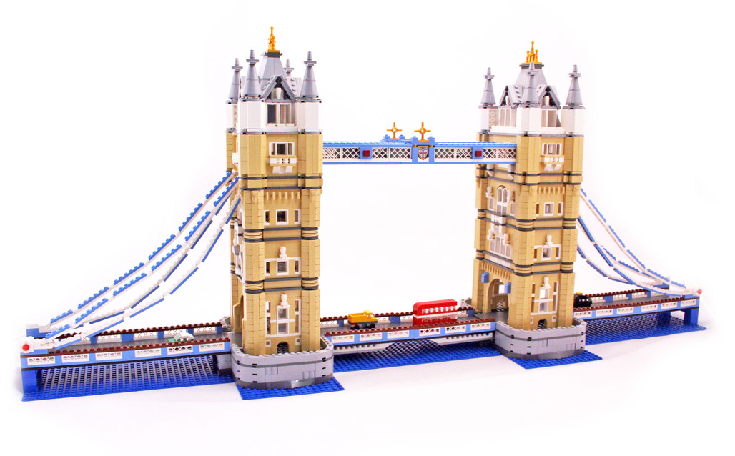
303(d) Program: Bridging the Gap
Environmental Data & Goals → 303(d) & TMDLs → Implementation
Monitoring
Permitting
Non-point Source
Standards

Slide 3
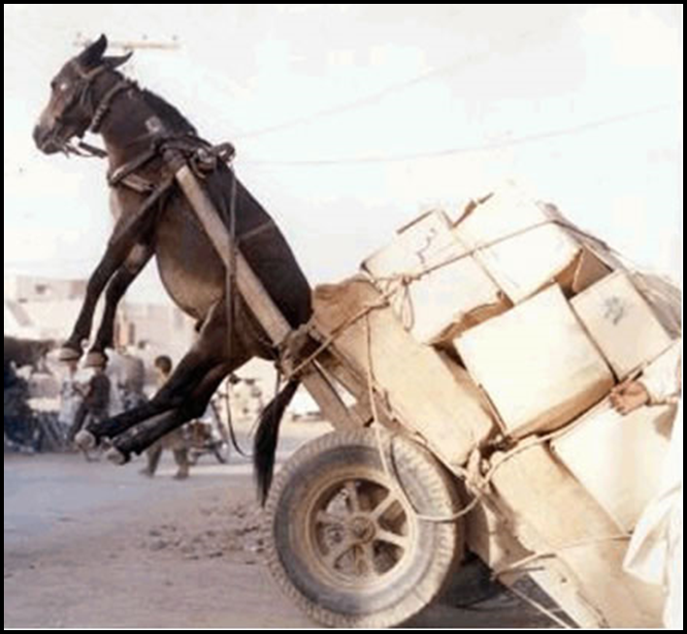
What is a TMDL?
TMDL = Total Maximum Daily Load
T = Tipping Point

Slide 4
303(d)/TMDL Program Vision: A Refresh of Program Focus
The CWA 303(d) program has evolved
Builds on lessons learned
Not a change to CWA requirements
Highlights flexibility for states
Coordination and focus for results

Slide 5
Clean Water Pursuit
~The New 303(d) Vision
Prioritization – Where do you focus first?
Assessment – How do you track priority areas?
Protection – How to protect high quality resources? Alternatives – What is the most effective path? Integration – How do you work with partners?
Engagement – How do you involve the public?
PRI
ASM
PRT
ALT
INT
ENG

Slide 6
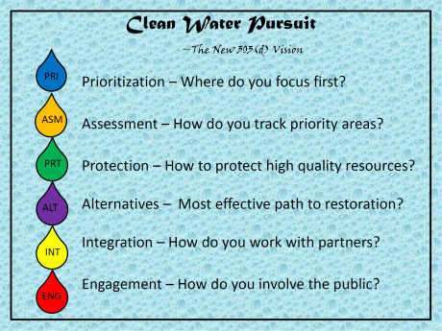
ALT
INT
PRT
Clean Water Pursuit
ENG
ASM
PRI

Slide 7
Clean Water Pursuit
~The New 303(d) Vision
Prioritization – Where do you focus first?
Does it reflect what is valuable to the public?
Are you effectively aligning resources?
Efficient allocation of time/resources?
PRI

Slide 8
Clean Water Pursuit
~The New 303(d) Vision
Prioritization –
~175 waterbodies on the list that need TMDLs
Evaluated the following indicators to prioritize:
Stressors
Ecological
Social
Input from stakeholders on priorities
PRI

Slide 9
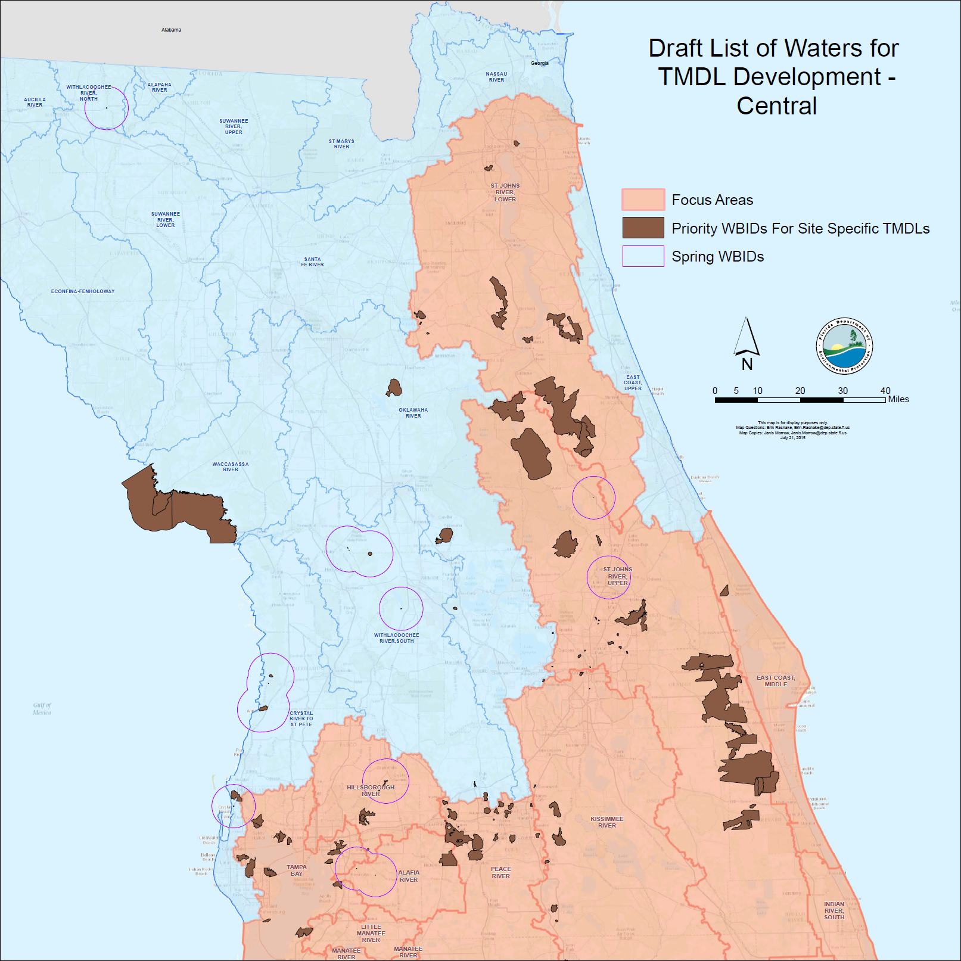

Slide 10
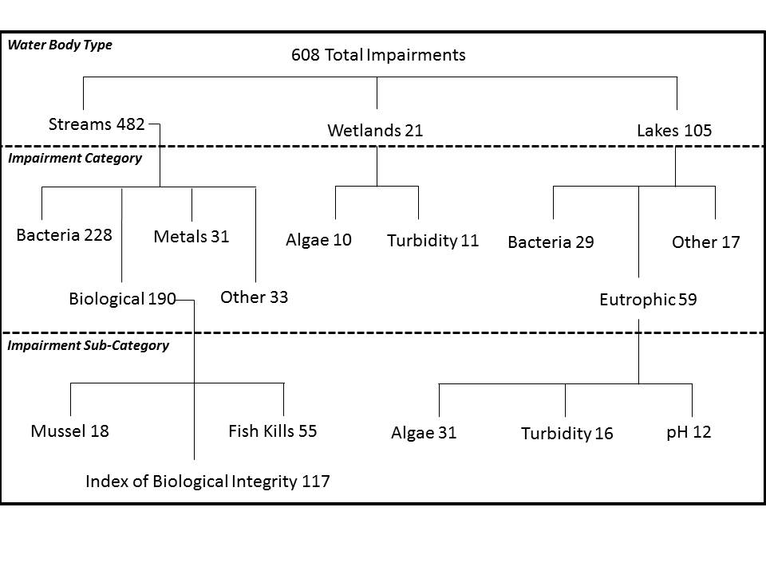

Slide 11
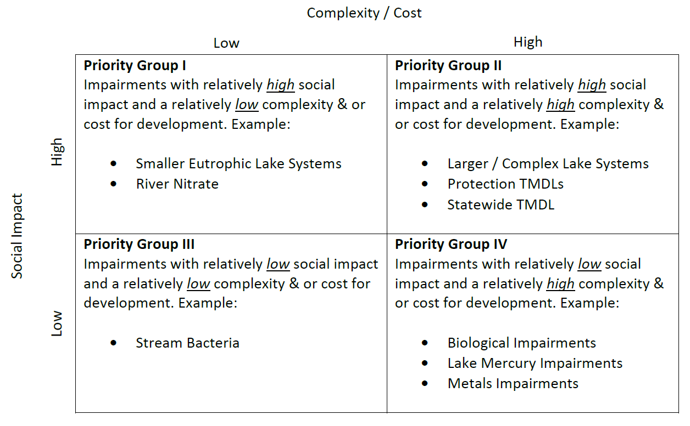
I
II
III
IV

Slide 12
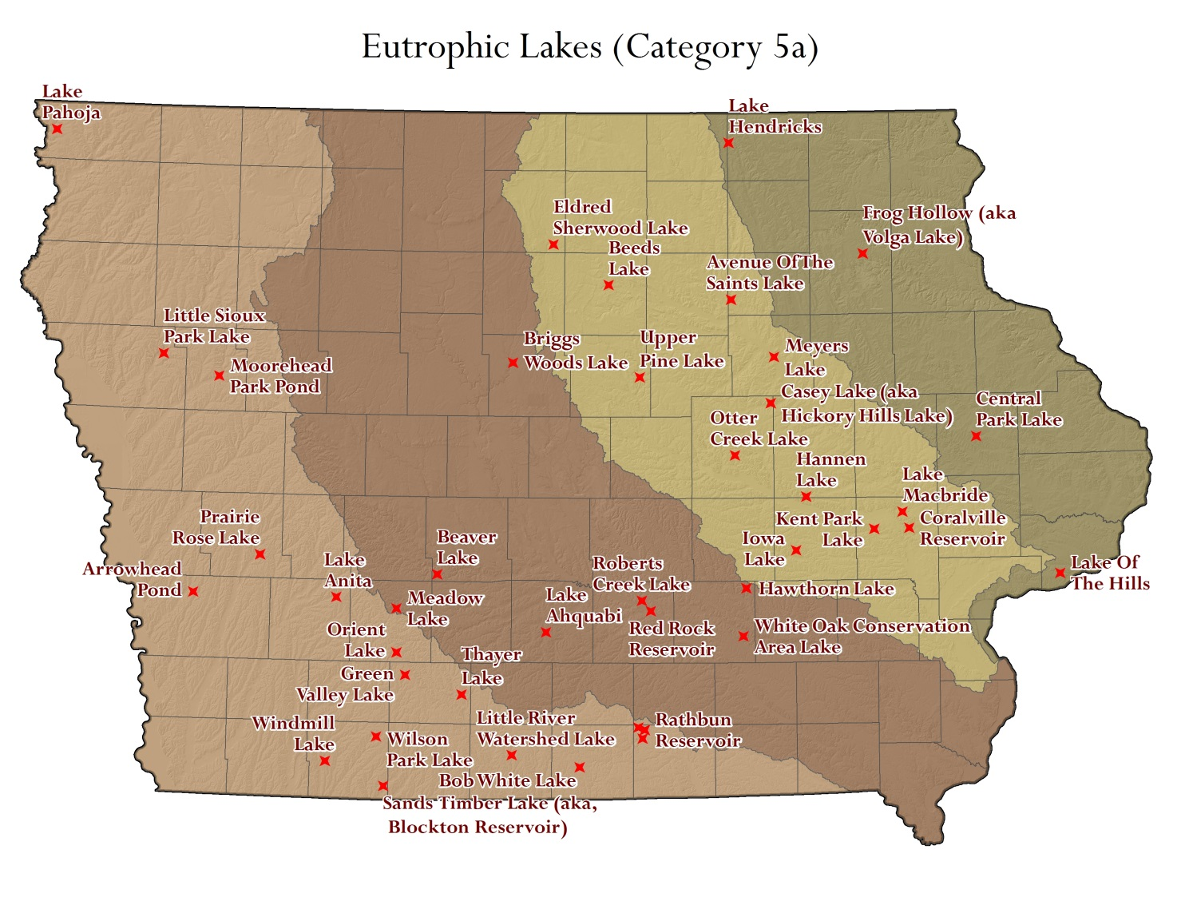

Slide 13
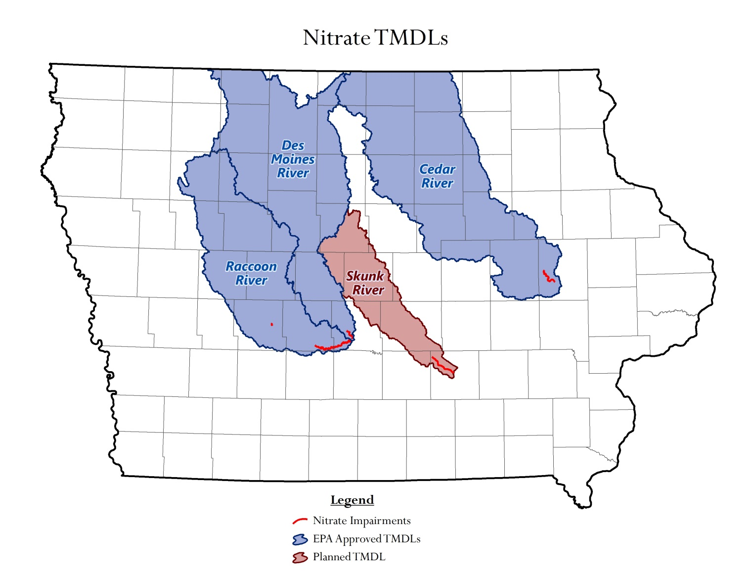

Slide 14
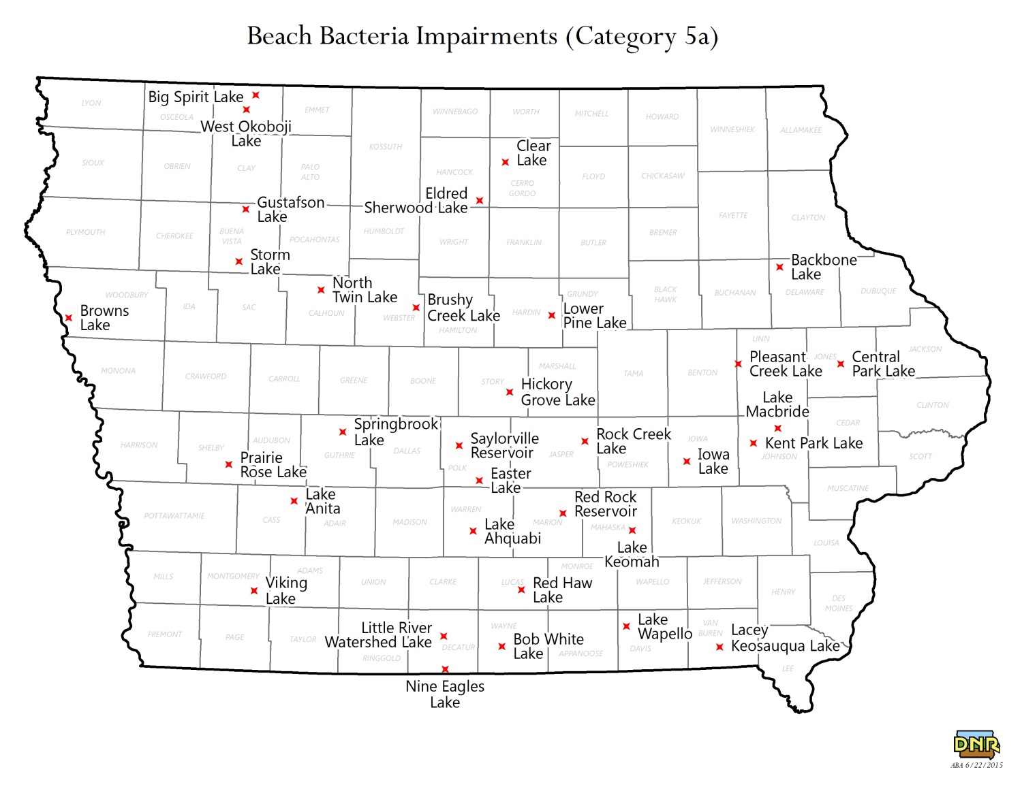

Slide 15
ALT
INT
PRT
Clean Water Pursuit
ENG
ASM
PRI

Slide 16
Clean Water Pursuit
~The New 303(d) Vision
Assessment – How do you gather priority info?
Are your monitoring efforts aligned with priorities?
How can you supplement to fill in gaps?
Evaluate success / provide feedback loop
ASM

Slide 17
Clean Water Pursuit
~The New 303(d) Vision
Assessment – How do you gather priority info?
Florida’s approach
Rotating basins on 5-year cycle
Collect data to fill gaps year prior to assessment
ASM

Slide 18
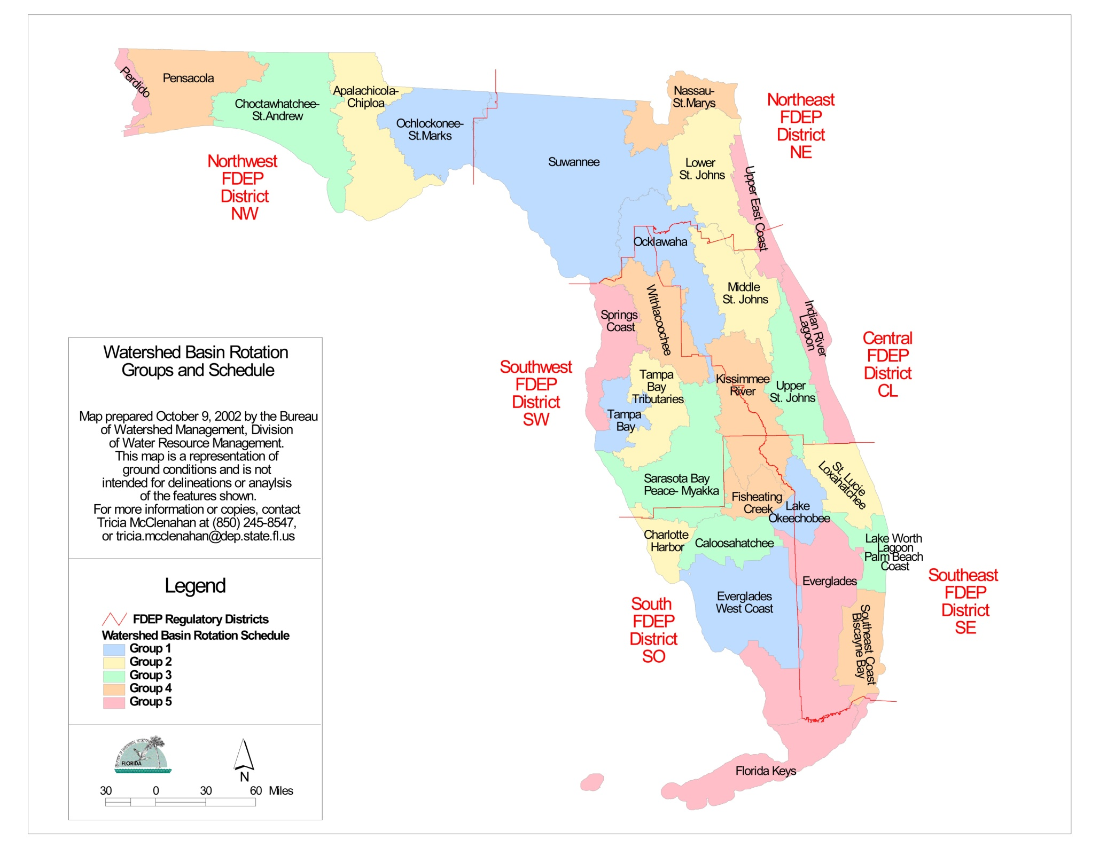

Slide 19
ALT
INT
PRT
Clean Water Pursuit
ENG
ASM
PRI

Slide 20
Clean Water Pursuit
~The New 303(d) Vision
Protection – How to protect high quality resources?
What’s a high quality resource?
How do you write a plan to protect waterbodies?
PRT

Slide 21
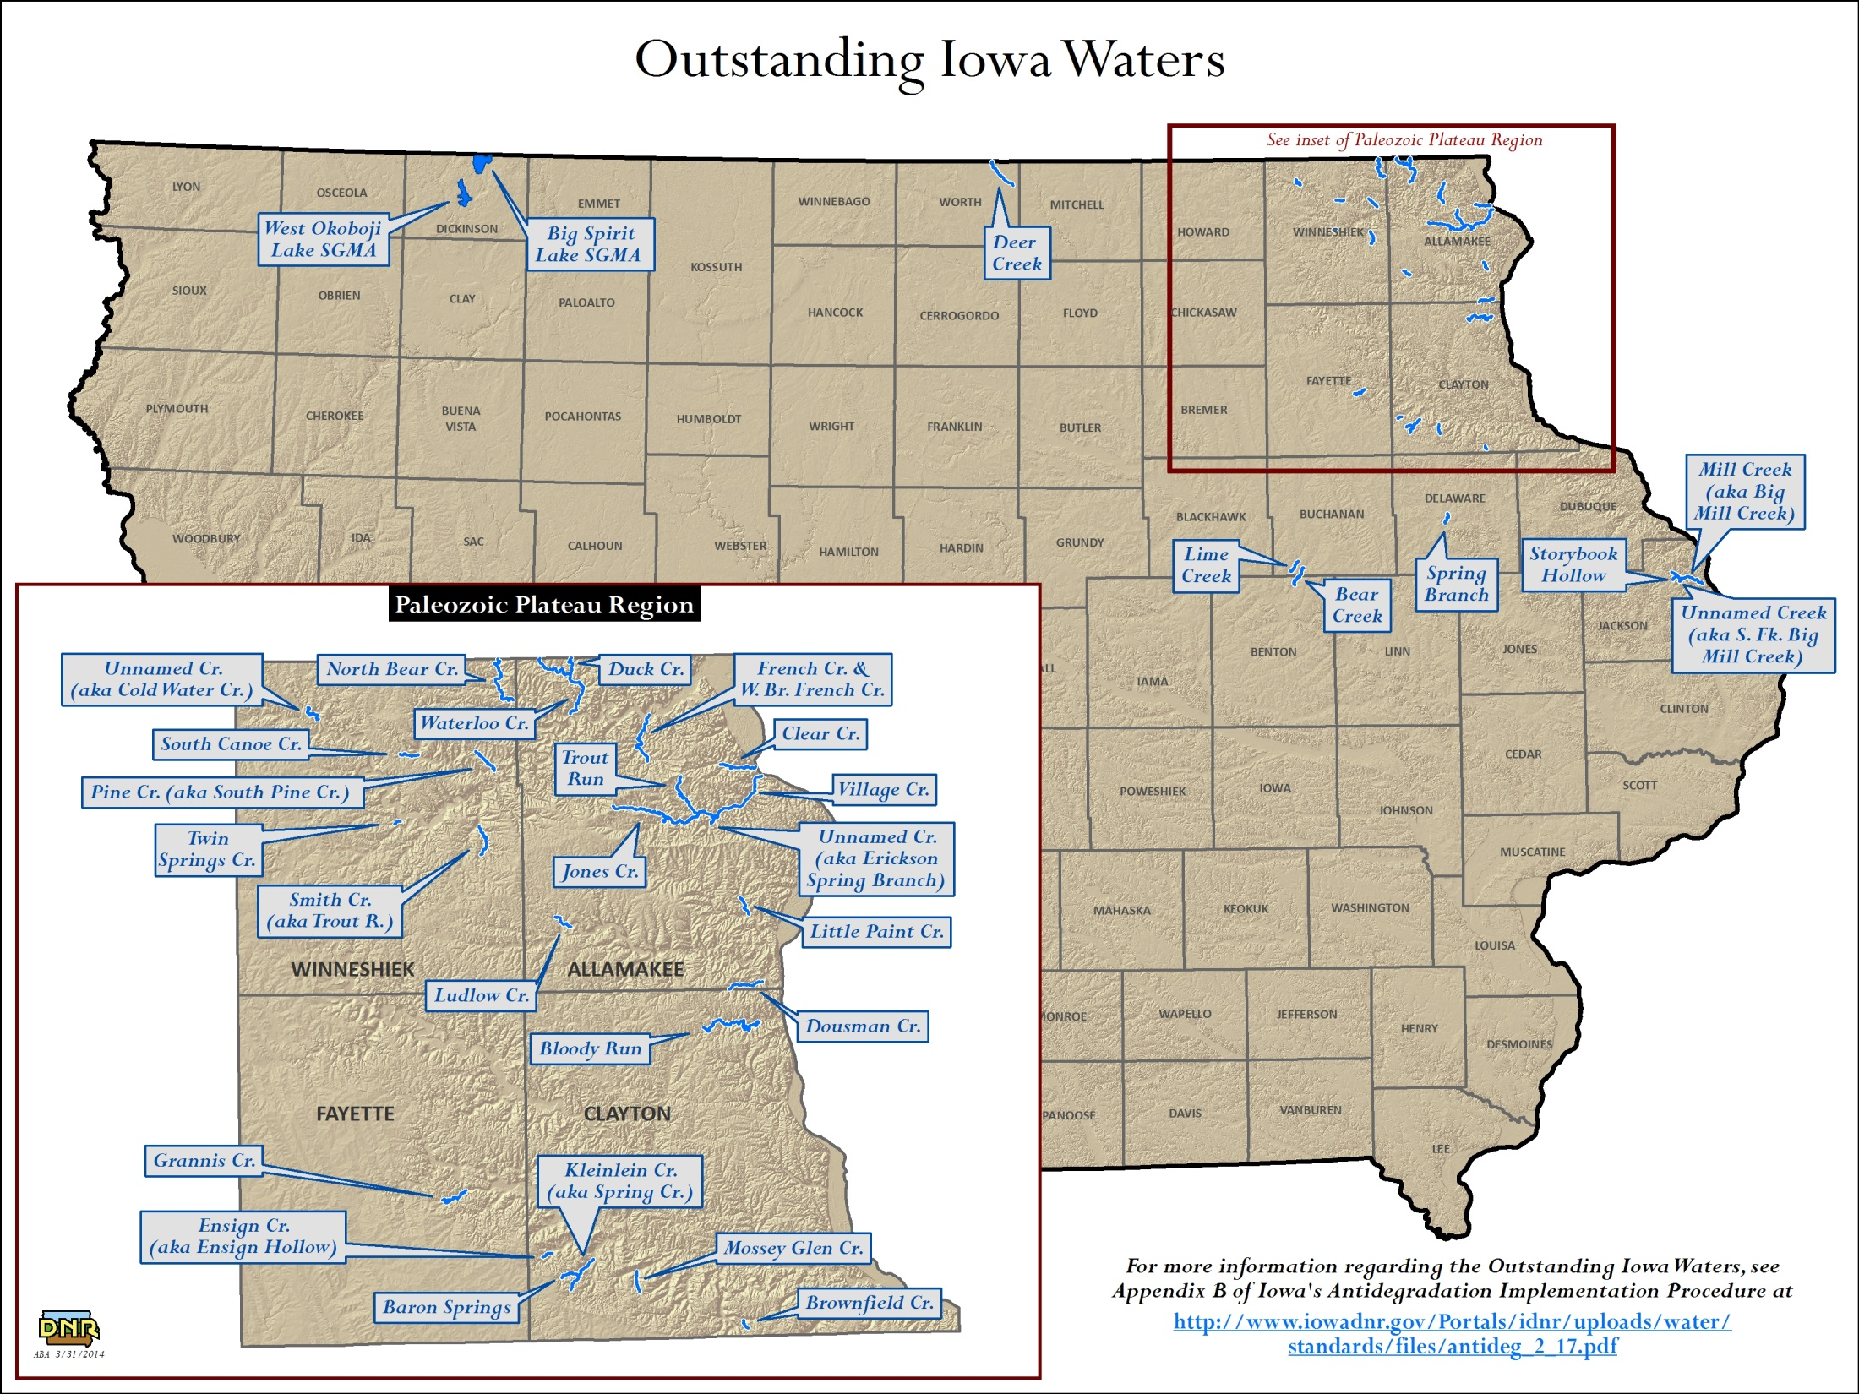

Slide 22
ALT
INT
PRT
Clean Water Pursuit
ENG
ASM
PRI

Slide 23
Clean Water Pursuit
~The New 303(d) Vision
Alternatives – What is the most effective path?
Options to restore quicker than with TMDL?
Straight to Implementation?
Watershed-Based Nonpoint Source Plans?
Other options?
ALT

Slide 24
Clean Water Pursuit
~The New 303(d) Vision
Alternatives – Which is the most effective path?
Florida’s activities
Public Outreach
Provide assistance
ALT
Pros | Cons
Quicker path to restoration | ?????
Stakeholders control their destiny
Acknowledge proactive efforts
Benefits to downstream waters
Time to develop good targets
Enhances public relation

Slide 25
ALT
INT
PRT
Clean Water Pursuit
ENG
ASM
PRI

Slide 26
Clean Water Pursuit
~The New 303(d) Vision
Integration – How do you work with partners?
How do you navigate the CWA pipeline?
What can you do to inform implementation?
NPDES, 319
How can you improve collaboration?
Monitoring, Standards
INT

Slide 27
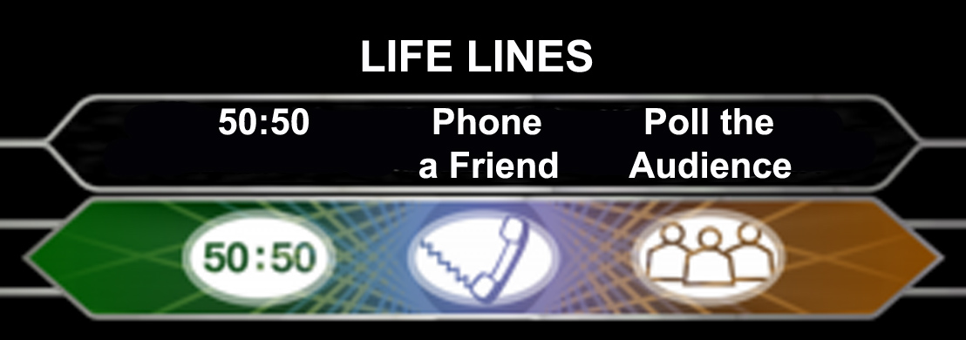
Clean Water Pursuit
~The New 303(d) Vision
???
INT

Slide 28
Phone-a-friend: TMDL as Switchboard
Water Quality Standards
Industrial Wastewater Limits & Monitoring
Water Quality Monitoring
Total Maximum Daily Load
Municipal Wastewater Limits & Monitoring
Confined Animal Feeding Operations Inspections
MS4 BMPs & Monitoring
Nonpoint Source BMPs & Monitoring

Slide 29
ALT
INT
PRT
Clean Water Pursuit
ENG
ASM
PRI

Slide 30
Clean Water Pursuit
~The New 303(d) Vision
Engagement – How do you involve the public?
Are you delivering useful / relevant information?
How can you improve written / verbal products?
ENG

Slide 31
Clean Water Pursuit
~The New 303(d) Vision
???
ENG

Slide 32
Clean Water Pursuit
~The New 303(d) Vision
Engagement – How do we involve you?
What’s most useful for you and your organization?
What words “work” and what do not?
ENG

Slide 33
ALT
INT
PRT
Clean Water Pursuit
ENG
ASM
PRI

Slide 34
Clean Water Pursuit
~The New 303(d) Vision
Prioritization – Focus on what’s important
Assessment – Collecting priority data
Protection – An idea worth investigating
Alternatives – Useful tools if the need arises
Integration – Breaking down CWA silos
Engagement – Clearer, simpler language
PRI
ASM
PRT
ALT
INT
ENG

Slide 35
Clean Water Pursuit
~The New 303(d) Vision
Amy Feingold – Game Master
EPA R4 – feingold.amy@epa.gov
Julie Espy – WQ Assessment Program Administrator
Florida DEP – julie.espy@dep.state.fl.us
Jeff Berckes – TMDL Program Coordinator
Iowa DNR - jeff.berckes@dnr.iowa.gov

