Slide 1
The Ethics of Communicating
Scientific Uncertainty
How Professional Standards Shape Scientists’, Lawyers’, and Journalists’ Approaches to Uncertainty
Friday, September 12, 2014
3:00pm-4:15pm Eastern Time
Hosted by the Environmental Law Institute
This webinar is made possible with support from
the National Science Foundation’s Paleoclimate Program
Questions for the panelists? Submit via the “Questions” box

Slide 2
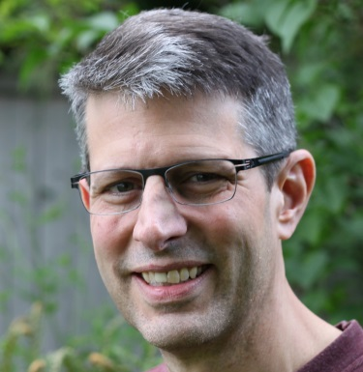
The Ethics of Communicating Scientific Uncertainty
How Professional Standards Shape Scientists’, Lawyers’, and Journalists’
Approaches to Uncertainty
Friday, September 12, 2014 • 3:00pm-4:15pm ET
Now Speaking:
Jay Austin
Senior Attorney, Environmental Law Institute
directs ELI’s Program on the Constitution, Courts, and Legislation. In that role, he produces scholarly research and commentary on environmental litigation; key areas of constitutional law, including the Commerce Clause, Fifth Amendment takings, and Article III standing; and on proposals to amend major federal laws like the National Environmental Policy Act and Endangered Species Act. Jay holds a B.A. in political philosophy from James Madison College at Michigan State University, and a J.D. from the University of Virginia School of Law.
Questions for the panelists? Submit via the “Questions” box
This webinar is made possible with support from the National Science Foundation’s Paleoclimate Program

Slide 3
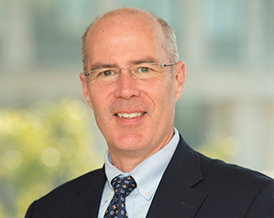
The Ethics of Communicating Scientific Uncertainty
How Professional Standards Shape Scientists’, Lawyers’, and Journalists’
Approaches to Uncertainty
Friday, September 12, 2014 • 3:00pm-4:15pm ET
Now Speaking:
George Gray
Department of Environmental & Occupational Health, George Washington University
In both academic and policymaking settings, Professor Gray has long been committed to the effective use of science to inform public health choices, and emphasizes the importance of communicating those choices effectively to citizens, journalists, and lawmakers. His areas of focus include nanotechnology, ecosystem research, the influence of toxicology advances on testing and risk assessment, and sustainability. Gray received his B.S. in Biology from the University of Michigan, and his M.S. (Toxicology) and Ph.D. from the University of Rochester School of Medicine and Dentistry.
Questions for the panelists? Submit via the “Questions” box
This webinar is made possible with support from the National Science Foundation’s Paleoclimate Program

Slide 4
Characterizing Uncertainty in Risks
George Gray
Center for Risk Science and Public Health
Department of Environmental and Occupational Health
Milken Institute School of Public Health

Slide 5
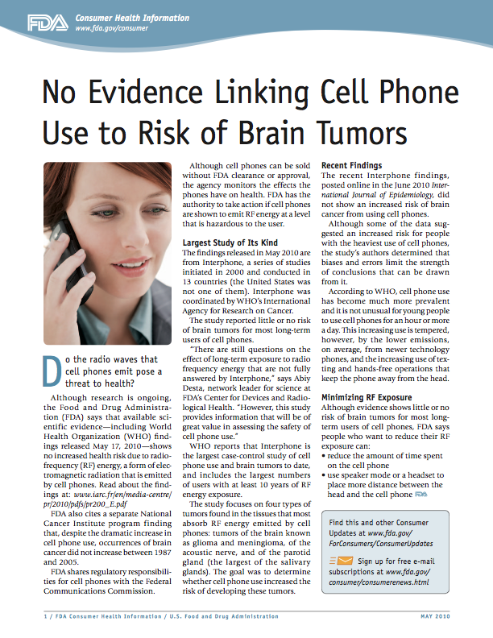
FDA
Although research is ongoing, the Food and Drug Administration (FDA) says that available scientific evidence—including World Health Organization (WHO) findings released May 17, 2010—shows no increased health risk due to radio- frequency (RF) energy, a form of electromagnetic radiation that is emitted by cell phones.
Despite the dramatic increase in cell phone use, occurrences of brain cancer did not increase between 1987 and 2005.

Slide 6
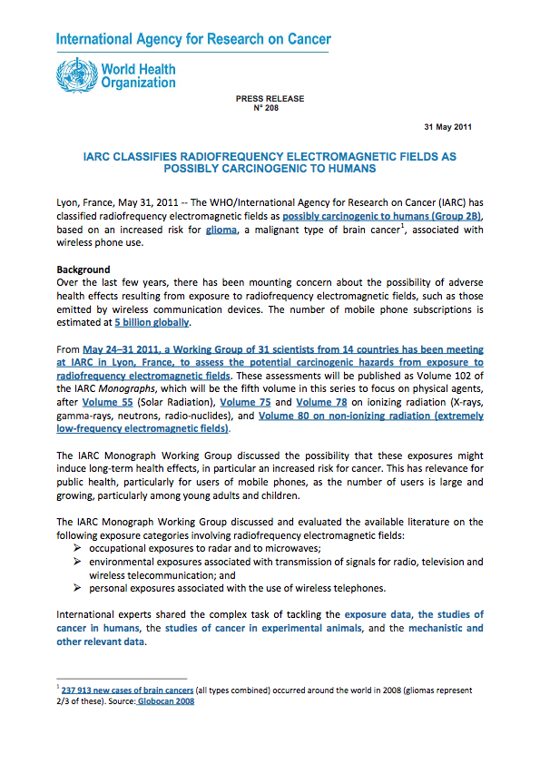
International Agency for Research on Cancer
"After reviewing all the evidence available, the IARC working group classified radiofrequency electromagnetic fields as possibly carcinogenic to humans," panel chairman Jonathan Samet, MD, chair of preventive medicine at the USC Keck School of Medicine, said at a news teleconference. "We reached this conclusion based on a review of human evidence showing increased risk of glioma, a malignant type of brain cancer, in association with wireless phone use."

Slide 7
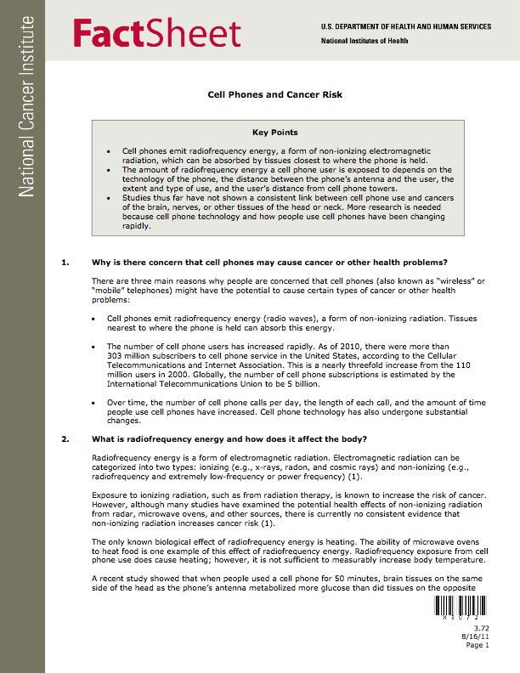
National Cancer Institute
Studies thus far have not shown a consistent link between cell phone use and cancers of the brain, nerves, or other tissues of the head or neck. More research is needed because cell phone technology and how people use cell phones have been changing rapidly.
Although there have been some concerns that radiofrequency energy from cell phones held closely to the head may affect the brain and other tissues, to date there is no evidence from studies of cells, animals, or humans that radiofrequency energy can cause cancer.

Slide 8
How Does This Happen?
Differences in the science?
Differences in interpretation of science?
Different judgments about acceptability of risk?
Something else?

Slide 9
Risk Means Uncertainty
Causal relationships
Likelihood of occurrence
Consequences

Slide 10
Science, Science Policy, and Policy
Science:
Positive
A process
Hypothesis
Data
Challenge
Science Policy:
“Trans-science”
How to Use Science in the Face of Uncertainty
Policy:
Normative
Tradeoffs
Judgment
Legal constraints
Pragmatic

Slide 11
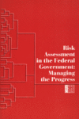
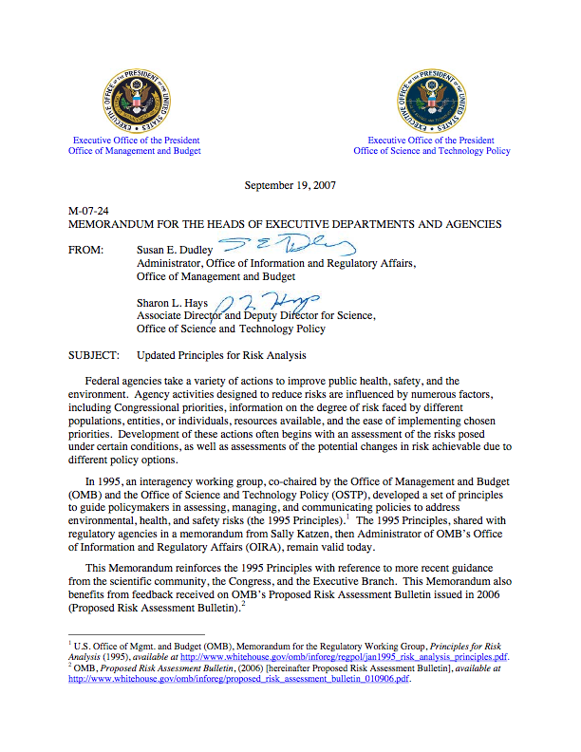
Uncertainty and Risk: Norms
Risk characterization should be …”the description of the nature and often the magnitude of human risk, including attendant uncertainty.”
Risk Assessment in the Federal Government: Managing the Process. National Academy of Sciences, 1983
“Judgments used in developing a risk assessment, such as assumptions, defaults, and uncertainties, should be stated explicitly. The rationale for these judgments and their influence on the risk assessment should be articulated.”

Slide 12
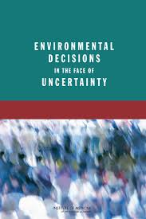
NAS/IOM
To better inform the public and decision makers, U.S. Environmental Protection Agency (EPA) decision documents and other communications to the public should systematically
Include information on what uncertainties in the health risk assessment are present and which need to be addressed;
Discuss how the uncertainties affect the decision at hand; and
Include an explicit statement that uncertainty is inherent in science, including the science that informs EPA decisions

Slide 13
Describing Uncertainty
Words
Words with specific quantitative implications
Quantitatively

Slide 14
Using Words
e.g., IARC Carcinogenicity
Group 1: Carcinogenic to humans
Group 2A: Probably carcinogenic to humans
Group 2B: Possibly carcinogenic to humans
Group 3: Not classifiable
Group 4: Probably not carcinogenic to humans
Question: Do the words mean the same thing to everyone?

Slide 15
Defining Words - IPCC
Working Group I definitions: “refers to a probabilistic assessment of some well defined outcome having occurred or occurring in the future”
Virtually certain: >99% probability (1:100)
Extremely likely: >95% (1:20)
Very likely: >90% (1:10)
Likely: > 66% (1:3)
More likely than not: >50%
Unlikely: <33%
Very unlikely: <10%
Exceptionally unlikely < 1%

Slide 16
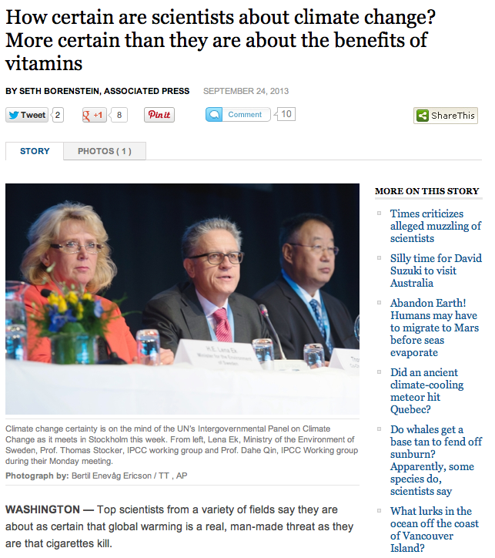
Hard to Communicate
“They'll even put a number on how certain they are about climate change. But that number isn't 100 per cent. It's 95 per cent. And for some non-scientists, that's just not good enough”
“Some climate-change deniers have looked at 95 per cent and scoffed. After all, most people wouldn't get on a plane that had only a 95 per cent certainty of landing safely, risk experts say”

Slide 17
Quantitative Descriptions
Characterize all sources of uncertainty as range or probability distribution of risk
Provide insight into magnitude of uncertainty
Common for some types of risks (e.g., engineering, space flight) or parts of risk process (e.g., probabilistic exposure assessment)

Slide 18
Lifetime Cancer Risk from Drinking Water with100 ppb of Chloroform
1.0
0.9
0.8
0.7
0.6
0.5
Probability
0.4
0.3
0.2
0.1
0.0
<-10
-9
-8
-7
-6
-5
-4
-3
-2
-1
0
Added Risk (Log 10)
source: Evans, J.S., Gray, G.M., Sielken, R.L., Jr., Smith, A.E., Valdez-Flores, C., and Graham, J.D. (1994) Use of Probabilistic Expert Judgment in Distributional Analysis of Carcinogenic Potency. Regulatory Toxicology and Pharmacology 20:15-36

Slide 19
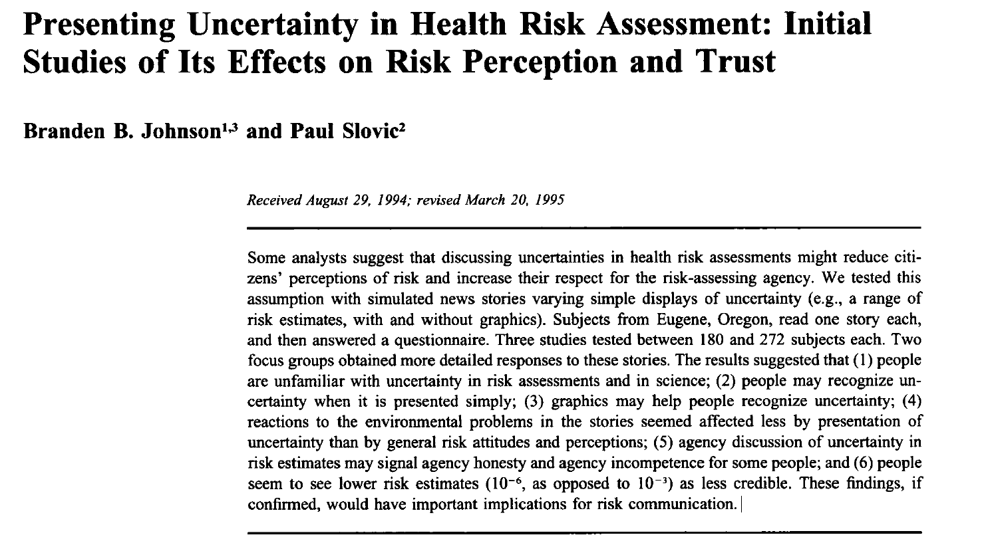
Communicating Uncertainty
“agency discussion of uncertainty in risk estimates may signal agency honesty and agency incompetence for some people”
Risk Analysis (1995) 15:485-494

Slide 20
Summary
Risk means uncertainty
Scientific norms encourage disclosure of sources and magnitude of uncertainty
Communicating uncertainty is hard!

Slide 21
Thank You!

Slide 22
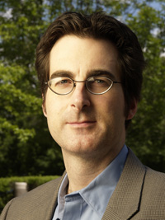
The Ethics of Communicating Scientific Uncertainty
How Professional Standards Shape Scientists’, Lawyers’, and Journalists’
Approaches to Uncertainty
Friday, September 12, 2014 • 3:00pm-4:15pm ET
Now Speaking:
Jim Hilbert
Expert Witness Training Academy, William Mitchell College of Law
is founder and executive director of the Center for Negotiation & Justice at the William Mitchell College of Law. He has served as a consultant and advisor to community organizations, civil rights groups, government agencies, and Fortune 500 companies throughout the world. Professor Hilbert is also the co-director of the Expert Witness Training Academy, which is funded by the National Science Foundation and provides training to climatologists on communicating in courtrooms and legislative hearings, and is co-director of the LL.M. Program at William Mitchell.
Questions for the panelists? Submit via the “Questions” box
This webinar is made possible with support from the National Science Foundation’s Paleoclimate Program

Slide 23
Scientific Uncertainty from the Perspective of the Lawyer
Jim Hilbert
Co- Director
Expert Witness Training Academy

Slide 24
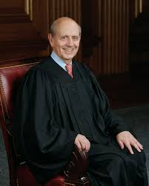
Key Objectives of the Legal System
Fairness
Justice
Finality
Predictability
“A court proceeding, such as a trial, is not simply a search for dispassionate truth. The law must be fair.”

Slide 25
Culture and Professional Norms
Adversarial system
Definition and role of “uncertainty” different for lawyers

Slide 26
Ethical Rules for Lawyers
Two Competing Mandates:
Advocacy for client (present the case with persuasive force)
Candor to the tribunal (avoid false evidence)

Slide 27
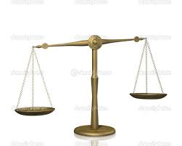
Burden of Proof
Civil Cases = Preponderance of the evidence
(“more likely than not”)
Criminal Cases = Beyond a reasonable doubt

Slide 28
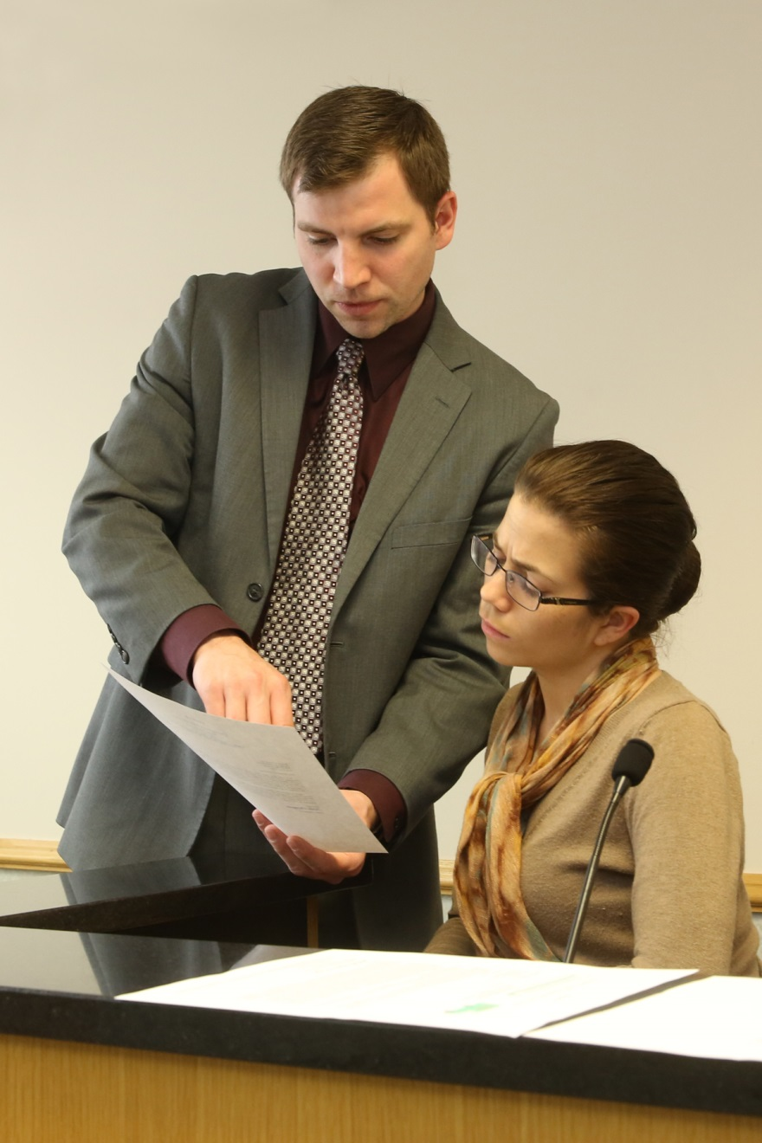
Rules of Evidence
Scientific evidence is traditionally presented by experts (not reports, articles, or studies on their own)

Slide 29
Expert Testimony
Experts must qualify in order to testify (Daubert standard)
Opinion must be 1) relevant and 2) valid and reliable
U.S. Supreme Court in Daubert: “Vigorous cross-examination, presentation of contrary evidence, and careful instruction on the burden of proof are the traditional and appropriate means of attacking shaky but admissible evidence.” 509 U.S. 579, 596 (1993).

Slide 30
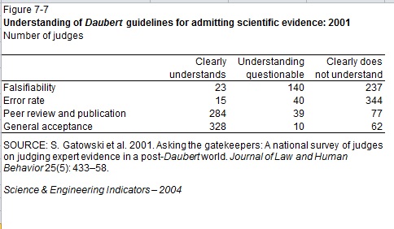
Judge as Gatekeeper
Researchers surveyed 400 state trial court judges in all 50 states. The survey results suggest that "many judges may not be fully prepared to deal with the amount, diversity and complexity of the science presented in their courtrooms" and that "many judges did not recognize their lack of understanding."
(S. Gatowski et al. 2001)

Slide 31
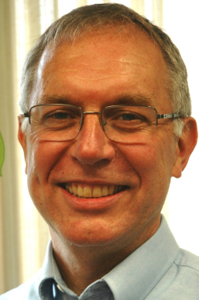
The Ethics of Communicating Scientific Uncertainty
How Professional Standards Shape Scientists’, Lawyers’, and Journalists’
Approaches to Uncertainty
Friday, September 12, 2014 • 3:00pm-4:15pm ET
Now Speaking:
David Poulson
Knight Center for Environmental Journalism, Michigan State University
is the Senior Associate Director of the Knight Center for Environmental Journalism at Michigan State University. He teaches environmental, investigative, computer-assisted, science and public affairs reporting to graduate and undergraduate students and organizes workshops for professional journalists. Before teaching at Michigan State, Poulson was a reporter and editor for more than 20 years, mostly reporting on the environment. He is the founder and the editor of GreatLakesEcho.org, a 5-year-old nonprofit regional environmental news service.
Questions for the panelists? Submit via the “Questions” box
This webinar is made possible with support from the National Science Foundation’s Paleoclimate Program

Slide 32
Uncertain Journalists

Slide 33
A lawyer, a scientist and a journalist walk into a bar…

Slide 34
What are journalistic norms for communicating uncertainty?

Slide 35
What are journalistic norms for communicating uncertainty?

Slide 36
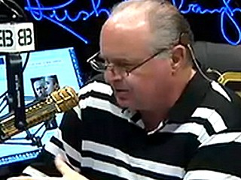
In 2007 Rush Limbaugh devoted more time to talking about climate models than The New Yorker, The Nation or Time magazine, NPR's Science Friday. (George Mason University.)

Slide 37
Meanwhile:
“[A]s newspapers have downsized, they've gotten rid of a lot of their science reporters. It takes experience and familiarity in order to put modeling into a story, yet we're losing the people who do it best.” (Karen Akerlof, lead author.)

Slide 38
Traditional values:
Be fair
Be accurate
Be engaging

Slide 39
Engagement strategies:
Short
Simple
Conflict

Slide 40
“The planet is warmer,” said the study.

Slide 41
“The planet is warmer,” said the scientific study.

Slide 42
“The planet is warmer,” said the peer-reviewed scientific study.

Slide 43
“The planet is warmer,” said the peer-reviewed scientific study. Peer review means that other scientists independently verified the quality of the study’s methodology prior to its publication.

Slide 44
“The planet is warmer,” said the study which was not peer-reviewed. That means that other scientists did not independently verify the quality of the study’s methodology prior to its publication.

Slide 45
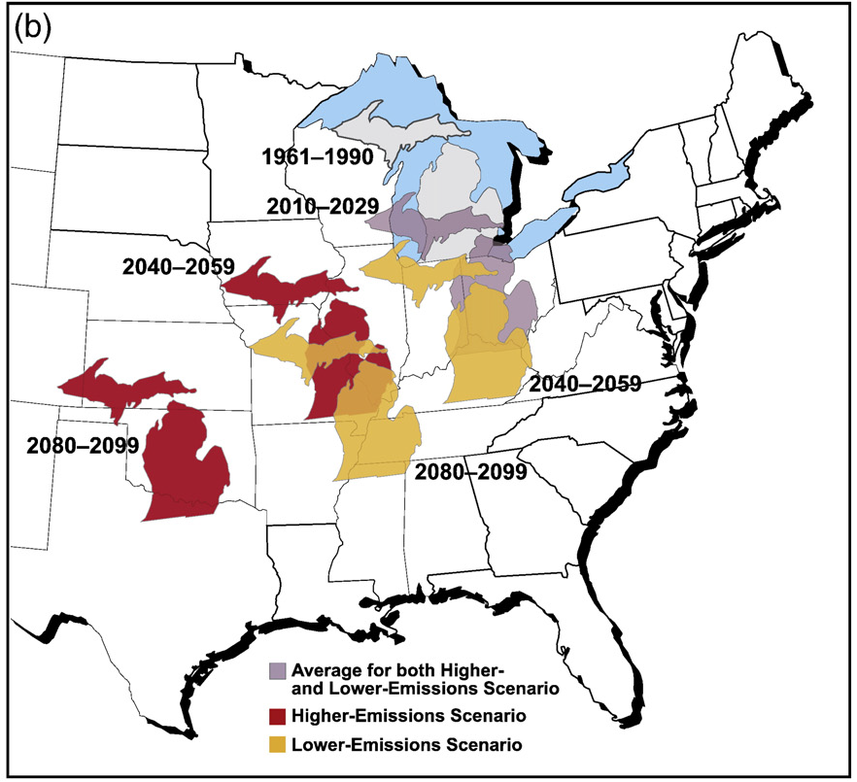
Projected Temperature Changes
Hayhoe et al (2010)
Notes:
Fig. 9. Projected changes in summer average temperature and rainfall for Illinois and Michigan indicate that summers in these states will feel progressively more like summers
currently experienced by states to their southwest under both SRES A1fi higher (red) and B1 lower (yellow) future emissions scenarios. Both states are projected to warm
considerably and have less summer rainfall.

Slide 46
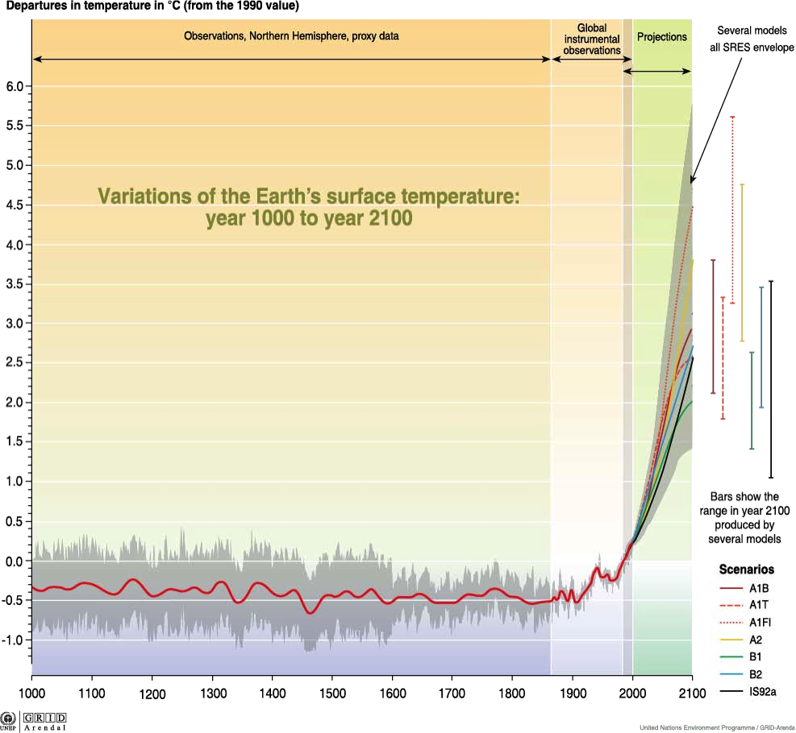

Slide 47
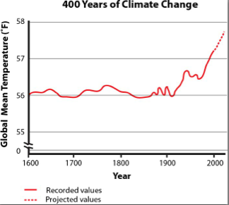

Slide 48
Are journalists skeptical about the scientific consensus of climate change?

Slide 49
Journalists still believe in
balanced reporting on climate change
In spite of the agreement (91.7%) on scientific consensus, more than one-third of environmental reporters (37.6%) believed that coverage of climate change science must reflect a balance of viewpoints or present all sides of controversy. Almost half (49.5%) did not believe in the need for balance. Another 12.8% of reporters held a neutral viewpoint on this issue.

Slide 50
Percent of journalists who indicated these are obstacles for climate change reporting

Slide 51
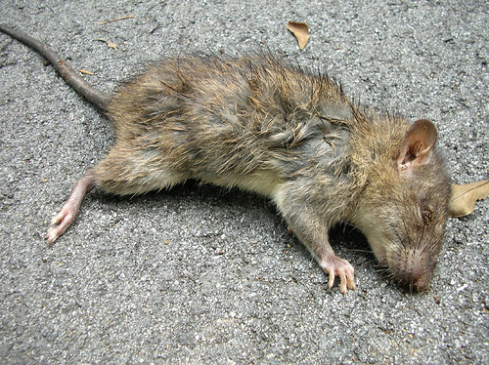
Dead Rat Journalism

Slide 52
BALANCE VS. TRUTH

Slide 53
Shuttle images show the roundness of the Earth.

Slide 54
Shuttle images show the roundness of the Earth.
Who do you talk to for the “other” side of this story?

Slide 55
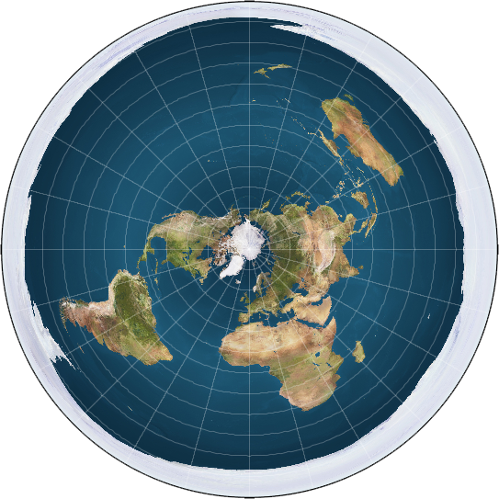
The International Flat Earth Society

Slide 56
The International Flat Earth Society
Q: When are you journalists going to start treating climate skeptics like the flat Earthers?

Slide 57
The International Flat Earth Society
Q: When are you journalists going to start treating climate skeptics like the flat Earthers?
A: Not soon.

Slide 58
Lack of expertise of some journalists
Lack of time of most journalists
It’s a political story
The Rachel Carson argument

Slide 59
At its best, journalism handles uncertainty by:
Deeply researching explanations and explaining which are probable and why some are wrong or unlikely
Reporting potential sources of bias of those advocating for particular explanations
Engaging an audience

Slide 60
Journalism without engagement is little more than keeping a diary

Slide 61
The Ethics of Communicating Scientific Uncertainty
How Professional Standards Shape Scientists’, Lawyers’, and Journalists’
Approaches to Uncertainty
Friday, September 12, 2014 • 3:00pm-4:15pm ET
Q & A Period
Questions for the panelists? Submit via the “Questions” box

Slide 62
How Professional Standards Shape Scientists’, Lawyers’, and Journalists’
Approaches to Uncertainty
Friday, September 12, 2014 • 3:00pm-4:15pm ET
Thank you for joining!
This webinar is made possible by generous support from the National Science Foundation’s Paleoclimate Program
The Ethics of Communicating Scientific Uncertainty

